Slide 1

COURSERA CAPSTONE PROJECT
By Aneervan Ray

Slide 2


The Battle of Neighborhoods

Slide 3
Agenda
Introduction
Data Section
Discussion
Conclusion
Methodology Section
Results

Slide 4
INTRODUCTION

Slide 5
Purpose and Audience
The purpose of this Project is to help people in exploring better facilities around their neighborhood. It will help people making smart and efficient decision on selecting great neighborhood out of numbers of other neighborhoods in Scarborough, Toronto.
Lots of people are migrating to various states of Canada and needed lots of research for good housing prices and reputed schools for their children. This project is for those people who are looking for better neighborhoods.
This Project aim is to create an analysis of features for a people migrating to Scarborough to search a best neighborhood as a comparative analysis between neighborhoods. The features include median housing price and better school according to ratings, crime rates of that particular area, road connectivity, weather conditions, good management for emergency, water resources both fresh and waste water and excrement conveyed in sewers and recreational facilities.

Slide 6
Libraries Used in Python
Pandas: For creating and manipulating dataframes.
Folium: Python visualization library would be used to visualize the neighborhoods cluster distribution of using interactive leaflet map.
Scikit Learn: For importing k-means clustering.
JSON: Library to handle JSON files.
XML: To separate data from presentation and XML stores data in plain text format.
Geocoder: To retrieve Location Data.
Beautiful Soup and Requests: To scrap and library to handle http requests.
Matplotlib: Python Plotting Module.

Slide 7
DATA SECTION
The Heart of our Project

Slide 8
Data Sources
Data Link: https://en.wikipedia.org/wiki/List_of_postal_codes_of_Canada:_M
We will use Scarborough dataset which we scrapped from wikipedia on Week 3. Dataset consisting of latitude and longitude, zip codes.
We will need data about different venues in different neighborhoods of that specific borough. In order to gain that information we will use "Foursquare" locational information. Foursquare is a location data provider with information about all manner of venues and events within an area of interest. Such information includes venue names, locations, menus and even photos. As such, the foursquare location platform will be used as the sole data source since all the stated required information can be obtained through the API.

Slide 9

Foursquare API Data
After finding the list of neighborhoods, we then connect to the Foursquare API to gather information about venues inside each and every neighborhood. For each neighborhood, we have chosen the radius to be 100 meter.
The data retrieved from Foursquare contained information of venues within a specified distance of the longitude and latitude of the postcodes. The information obtained per venue as follows:
Neighborhood
Neighborhood Latitude
Neighborhood Longitude
Venue
Name of the venue e.g. the name of a store or restaurant
Venue Latitude
Venue Longitude
Venue Category

Slide 10
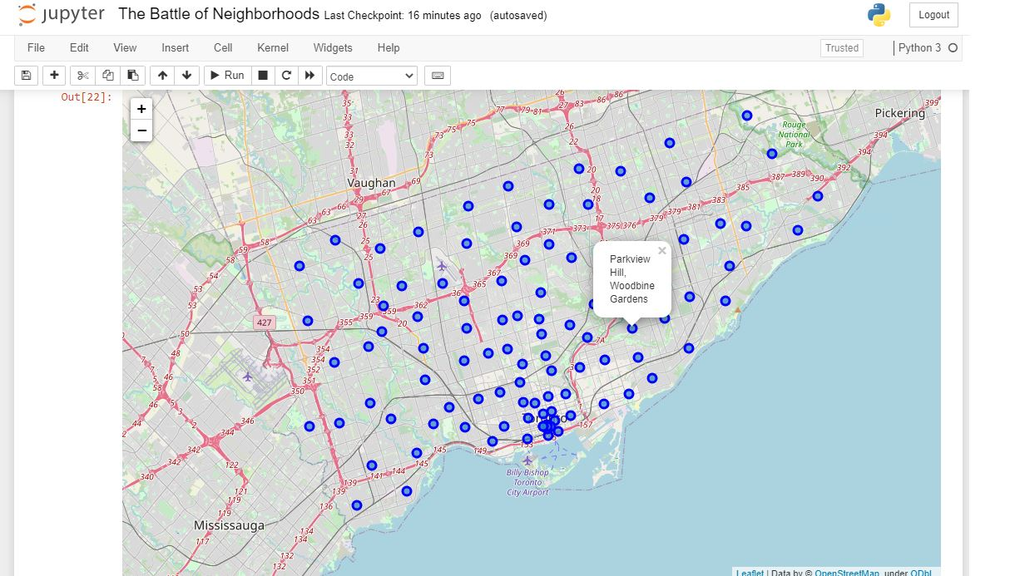
Map of Scarborough
Scarborough is a popular destination for new immigrants in Canada to reside. As a result, it is one of the most diverse and multicultural areas in the Greater Toronto Area, being home to various religious groups and places of worship. Although immigration has become a hot topic over the past few years with more governments seeking more restrictions on immigrants and refugees, the general trend of immigration into Canada has been one of on the rise.

Slide 11
METHODOLOGY SECTION
The Heart of our Project

Slide 12
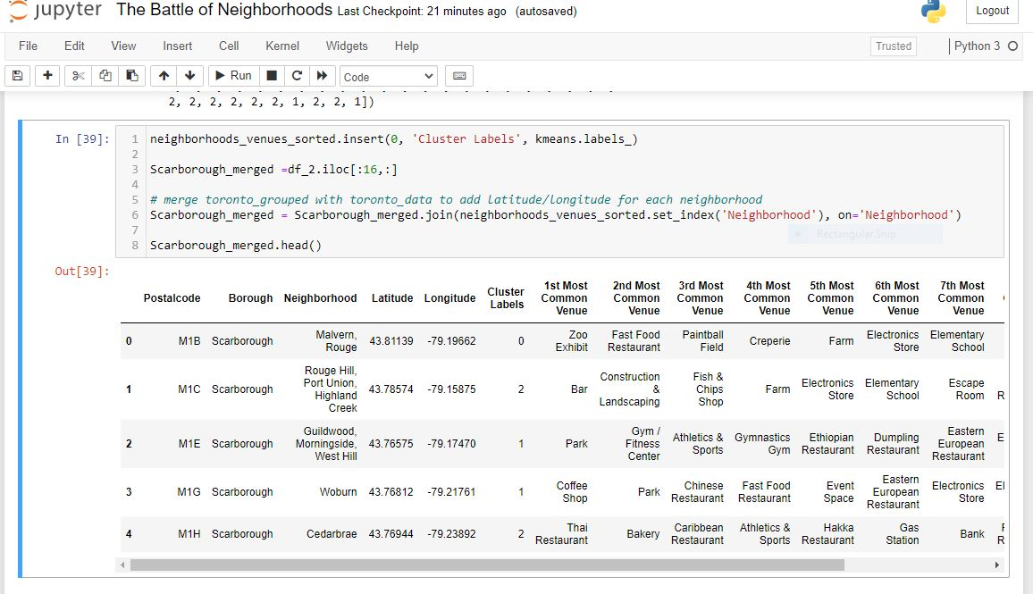
K-Means Clustering

Slide 13
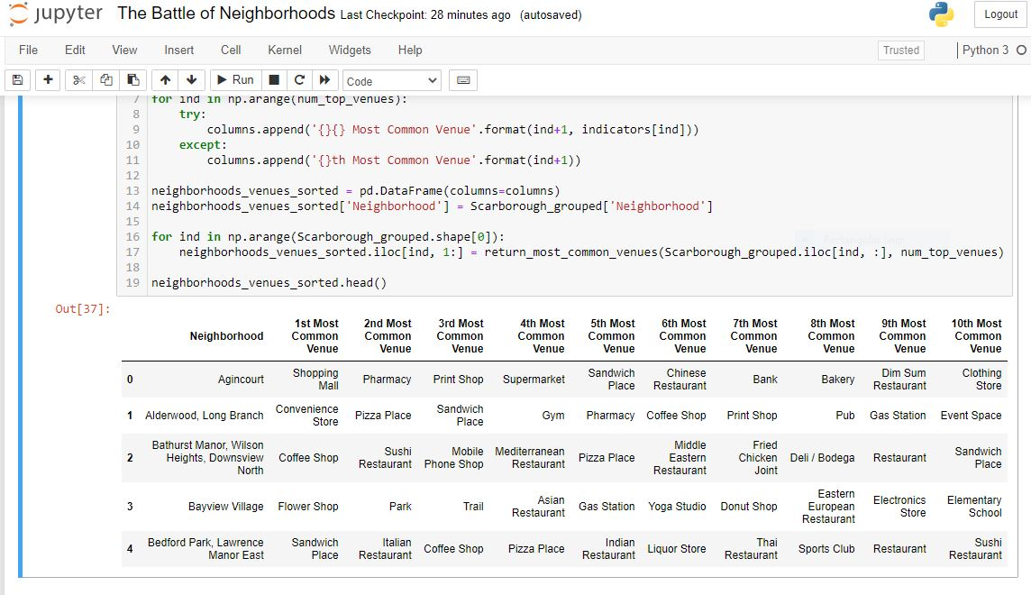
Most common venues near Neighborhood

Slide 14
RESULT SECTION
Run our Codebase

Slide 15
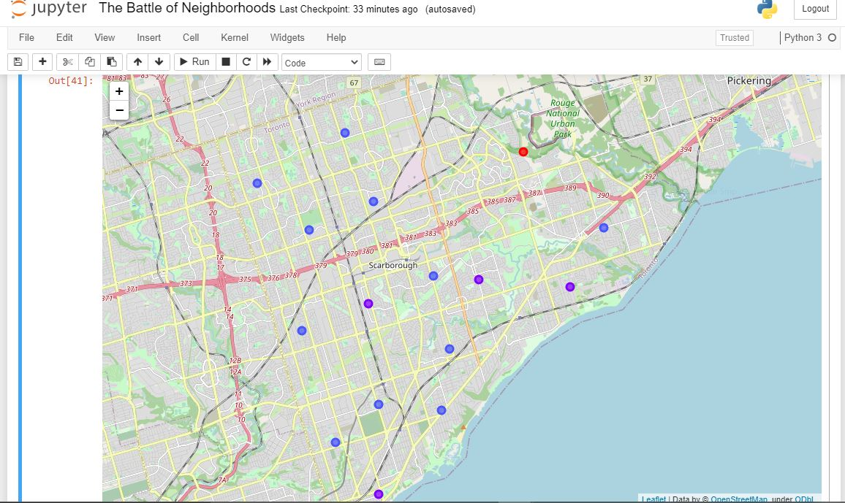
Map of Clusters in Scarborough

Slide 16
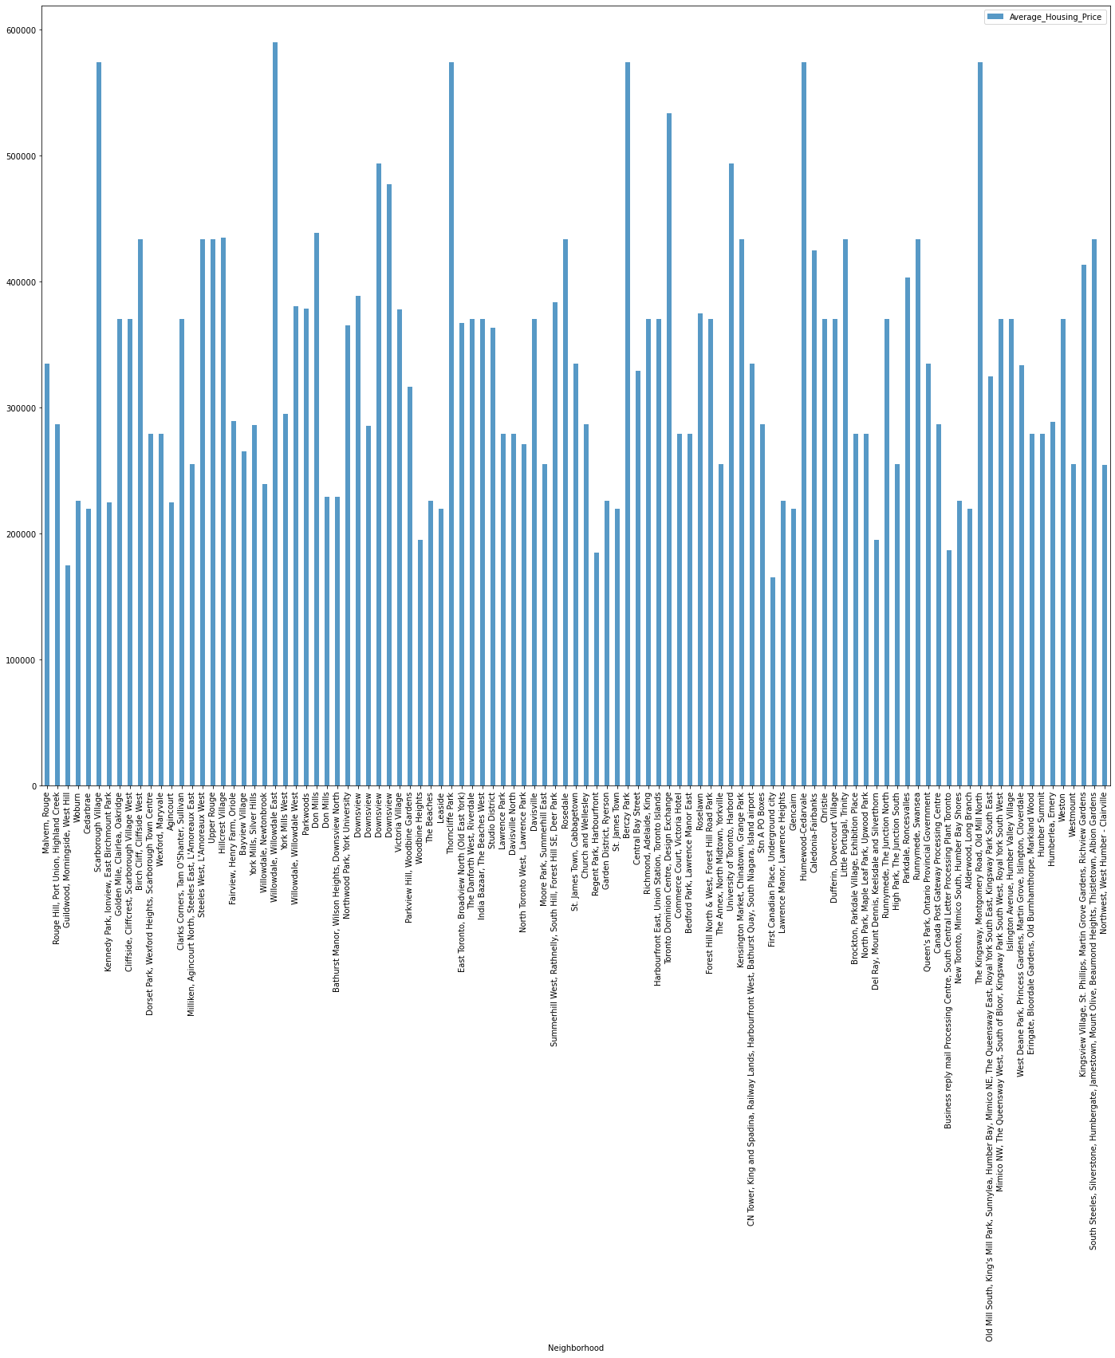
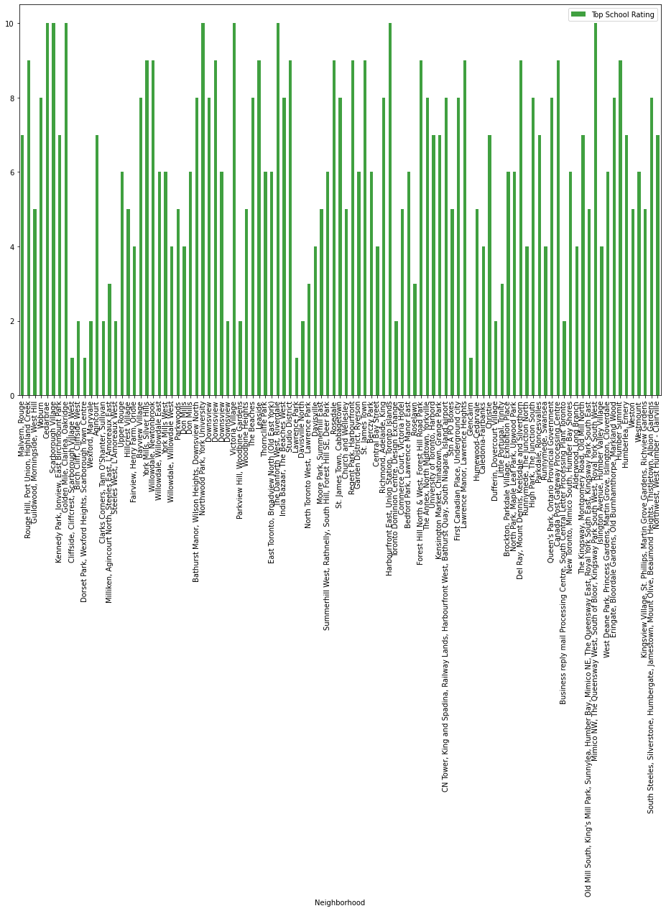
Clusters in Scarborough
Average House Pricing
School Ratings

Slide 17
DISCUSSION

Slide 18
Problem To Solve
The major purpose of this project, is to suggest a better neighborhood in a new city for the person who are shiffting there. Social presence in society in terms of like minded people. Connectivity to the airport, bus stand, city center, markets and other daily needs things nearby.
Sorted list of house in terms of housing prices in a ascending or descending order
Sorted list of schools in terms of location, fees, rating and reviews

Slide 19
CONCLUSION

Slide 20
Conclusion
In this project, using k-means cluster algorithm I separated the neighborhood into 10(Ten) different clusters and for 103 different lattitude and logitude from dataset, which have very-similar neighborhoods around them. Using the above charts results are presented to a particular neighborhood based on average house prices and school rating have been made.
I feel rewarded with the efforts and believe that this course with all the topics covered is well worthy of appreciation. This project has shown me a practical application to resolve a real situation that has impacting personal and financial impact using Data Science tools. The mapping with Folium is a very powerful technique to consolidate information and make the analysis and decision better with confidence.
This project can be continued for making it more precise in terms to find best house in Scarborough. Best means on the basis of all required things(daily needs or things we need to live a better life) around and also in terms of cost effective.

Slide 21

THANK YOU

